Slide 1
Office 365 Development

Slide 2
Course Agenda
Introduction to Office 365 Development
Module 1: Deep Dive Apps for Office in Outlook
Module 2: Deep Dive Apps for Office in Word
Module 3: Deep Dive Apps for Office in PowerPoint
Module 4: Deep Dive Apps for Office in Excel
Module 5: Deep Dive into SharePoint Hosted Apps
Module 6: Deep Dive into Provider Hosted Apps
Module 7: Deep Dive into Security and OAuth
Module 8: App Lifecycle Management

Slide 3
Deep Dive into Security and OAuth

Slide 4

Agenda
Azure Active Directory
OAuth Primer
Development Scenarios
OAuth Flows
Notes:
What new APIs are available, in preview, in the Office 365 Platform
How to use these API’s in your platform of choice
Some sample business scenarios for leveraging these API’s
Level: Intermediate
Audience: Developer Essentials

Slide 5















Vision
EXTEND OFFICE EVERYWHERE
CONNECT TO OFFICE 365 SERVICES
BUILD USING AN OPEN PLATFORM
Delve
z
Users and groups
Files
Mail
Calendar
My Apps
Video Portal
Contacts
Office Graph
Presentations
Documents
Spreadsheets
Lync
OneNote
Yammer

Slide 6
Azure Active Directory

Slide 7
Azure Active Directory
Identity and Access Management for the cloud
Can create new directories or manage existing ones in Azure subscription
Used by Office 365 for authentication
Used by Azure for user authentication and application authorization
Notes:
Azure Active Directory is a comprehensive identity and access management cloud solution. It combines core directory services, advanced identity governance, security, and application access management. Azure AD also offers developers an identity management platform to deliver access control to their applications, based on centralized policy and rules.

Slide 8
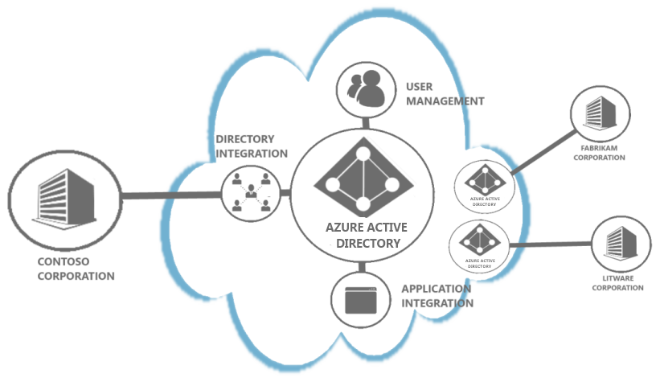
Organizational Accounts
Term for User Accounts in AAD
Required to Access Microsoft Cloud Services
Tenant-Based
Notes:
An organizational account is an extension of your computer network that someone from your organization, typically an administrator from your IT department, sets up with Microsoft to provide their users with access to paid Web services or applications hosted in the cloud. For the administrator to provide access to users, they must first create individual user accounts in Windows Azure Active Directory (Windows Azure AD), specify which licensed services the account can access, and then assign each person their individual user ID and password so they can sign in to those services for which they have been assigned licenses to. User accounts stored in Windows Azure AD are referred to as organizational accounts.

Slide 9
Link Office 365 and Azure
Log into Microsoft Azure subscription as administrator
Click on the Active Directory link.
Click New>Active Directory>Directory>Custom Create
Select to Add an Existing Directory
Follow the steps to add an existing directory
Notes:
It’s not required to link the Office 365 Directory to an Azure subscription
for simply creating provider-hosted apps, but it makes life a bit easier
and opens up the ability to call into Office 365 from other applications.

Slide 10
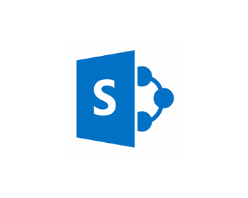

User Authentication

Slide 11
User Authentication
User attempts to access
SharePoint online resource

Slide 12
User Authentication
Redirected to
login.microsoftonline.com

Slide 13
User Authentication
Login with
Organizational Account

Slide 14
User Authentication
Issue SAML token

Slide 15
User Authentication
Present token

Slide 16
User Authentication
Return FedAuth cookie

Slide 17
User Authentication
Subsequent requests
Utilize FedAuth cookie

Slide 18
OAuth Primer

Slide 19
What is OAuth 2.0?
Simple mechanism to grant a third party access to a user’s resources without sharing the user’s password.
Cross platform app authorization
Internet Standard supported by Azure, Facebook, Google, Twitter, and more
Notes:
OAuth provides a simple mechanism for end-users to grant a third party access to their data and resources without sharing their passwords.
It also enables the user to grant access limited by scope and duration.

Slide 20
OAuth 2.0 Actors
Client: application requesting access to a user’s resources
Resource Owner: the user who can grant rights to the application
Resource Server: the server hosting the protected resources and exposing a web-based API
Authorization Server – server issuing tokens
Notes:
Client
An application making requests to access protected resources on behalf of the resource owner and with its authorization. This role is defined independently from how it is implemented. It has the same meaning whether is is implemented as an application that executes on a server computer, a desktop computer, or a mobile device). In Concur, the client is referred to as a partner application.
Resource owner
An entity capable of granting access to a protected resource. This is generally an end user.
Resource server
A server hosting the protected resources of the resource owner, capable of accepting and responding to API requests using access tokens.
Authorization server
A server issuing access tokens to the client after successfully authenticating the resource owner and obtaining authorization.

Slide 21
OAuth 2.0 Actors in Office 365
Client: SharePoint app, Azure web application, Windows 8 app
Resource Owner: individual or administrator with an Organizational Account in Azure Active Directory
Resource Server: SharePoint, Exchange
Authorization Server: Azure Access Control Services

Slide 22
Application Principals
Client ID is used to uniquely identify applications
Client Secret is used to authenticate token requests
Notes:
Client ID is a unique identifier
Client Secret is shared between the app and the authorization server
Forms the basis for apps as first-class principals

Slide 23
OAuth 2.0 Tokens
Context Token
Information about the Resources Owner and Client that can be used to get an Access Token later.
Refresh Token
A token used to get an Access Token from the Authorization Server.
Access Token
A token passed to the Resource Server authorizing the Client to access resources.
Authorization Code
A code that can be used to register an app on-the-fly.
Notes:
In the OAuth 2.0 model, access to protected resources is done using access tokens —an object with a specific scope, lifetime, and other access attributes. OAuth access tokens are sometimes compared to valet keys. In the same way as a valet key gives restricted access to a car, allowing a valet to drive it but not open the trunk or the glove compartment, the access token allows a client application restricted access to a user’s data at a resource server via tokens issued by an authorization server in response to the user authorizing access.
With OAuth 2.0, a third-party application does not use the resource owner's credentials to access protected resources. Instead, the third-party application obtains an access token. Access tokens are issued to third-party clients by an authorization server with the approval of the resource owner. The client uses the access token to access the protected resources hosted by the resource server.

Slide 24
Bearer Tokens
OAuth 2.0 Access Tokens are unbound tokens (a.k.a, “Bearer Tokens”)
An Access Token can be used by any application that possesses it
Always use SSL – OAuth design depends on it!
Never expose tokens in JavaScript or allow them to be accessed by client-side debugging tools
If an Access Token is compromised, damage is limited by expiration
If a Refresh Token is compromised, damage is limited because the Client ID and Client Secret are required to get an Access Token from a Refresh Token.

Slide 25
Development Scenarios

Slide 26
Provider-Hosted Apps
Development Scenarios

Slide 27
App Principals
Apps must be registered with SharePoint online
Client ID – generated during the registration process
Client Secret – generated during the registration process
App Host Domain – the domain of the Azure web site hosting the app
Redirect URL – the URL of the return page after permissions are granted
SharePoint provides registration management pages
AppRegNew.aspx – for registering a new app
AppInv.aspx – for updating registered apps
AppPrincipals.aspx – lists all registered apps
Notes:
Apps are first-class principals in SharePoint
They have an identifier and permissions, which are tracked in SharePoint through the registration and installation process

Slide 28
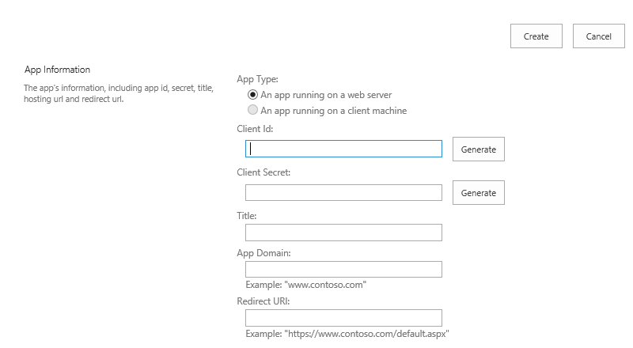
Registering a New App
Generated value
Generated value
Free text value
Azure domain (e.g., myapp.azurewebsites.net)
Web address (e.g., https://myapp.azurewebsites.net)
Notes:
Apps must be registered with SharePoint. This page will generate a new client ID and secret for the app. If deployed to Azure, use that information to fill out the rest of the form.

Slide 29
Provider-Hosted App Flow Scenario
User has Organizational Account
App registered with SharePoint Online
App deployed to SharePoint Online
Remote Web deployed as an Azure Website
Client ID and Client Secret defined in AAD

Slide 30


OAuth 2.0 Flow Provider-Hosted App
Azure Web Site
(Client)
End User
(Resource Owner)
Azure ACS
(Authorization Server)
SharePoint Online
(Resource Server)

Slide 31
OAuth 2.0 Flow Provider-Hosted App
Azure Web Site
(Client)
End User
(Resource Owner)
User launches app
Azure ACS
(Authorization Server)
SharePoint Online
(Resource Server)

Slide 32
OAuth 2.0 Flow Provider-Hosted App
Azure Web Site
(Client)
End User
(Resource Owner)
Request Context token
for user
Azure ACS
(Authorization Server)
SharePoint Online
(Resource Server)

Slide 33
OAuth 2.0 Flow Provider-Hosted App
Azure Web Site
(Client)
End User
(Resource Owner)
Context Token returned
Azure ACS
(Authorization Server)
SharePoint Online
(Resource Server)

Slide 34
OAuth 2.0 Flow Provider-Hosted App
Azure Web Site
(Client)
Context Token returned
and user redirected to app
End User
(Resource Owner)
Azure ACS
(Authorization Server)
SharePoint Online
(Resource Server)

Slide 35
OAuth 2.0 Flow Provider-Hosted App
Azure Web Site
(Client)
End User
(Resource Owner)
App extracts Refresh Token
from Context Token
Azure ACS
(Authorization Server)
SharePoint Online
(Resource Server)

Slide 36
OAuth 2.0 Flow Provider-Hosted App
Azure Web Site
(Client)
App requests Access Token
using refresh Token
End User
(Resource Owner)
Azure ACS
(Authorization Server)
SharePoint Online
(Resource Server)

Slide 37
OAuth 2.0 Flow Provider-Hosted App
Azure Web Site
(Client)
Access Token returned
End User
(Resource Owner)
Azure ACS
(Authorization Server)
SharePoint Online
(Resource Server)

Slide 38
OAuth 2.0 Flow Provider-Hosted App
Azure Web Site
(Client)
End User
(Resource Owner)
Access Token presented
Along with request
Azure ACS
(Authorization Server)
SharePoint Online
(Resource Server)

Slide 39
OAuth 2.0 Flow Provider-Hosted App
Azure Web Site
(Client)
End User
(Resource Owner)
Response returned
Azure ACS
(Authorization Server)
SharePoint Online
(Resource Server)

Slide 40
SharePointAcsContext Class
Inherits SharePointContext
Provides specific properties and methods for dealing with context and access tokens
CSOM
CreateAppOnlyClientContextForSPAppWeb
CreateAppOnlyClientContextForSPHost
CreateUserClientContextForSPAppWeb
CreateUserClientContextForSPHost
REST
AppOnlyAccessTokenForSPAppWeb
AppOnlyAccessTokenForSPHost
UserAccessTokenForSPAppWeb
UserAccessTokenForSPHost
Notes:
Abstracts the management of tokens to make it easier

Slide 41
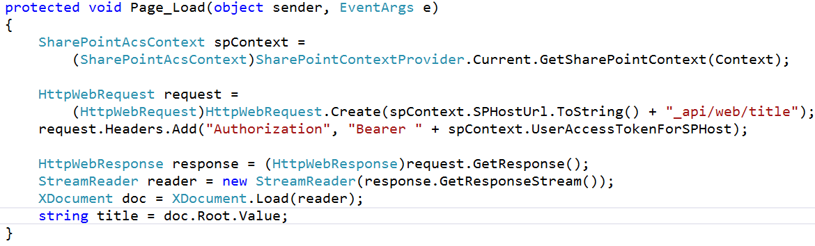
Making REST Calls with OAuth

Slide 42
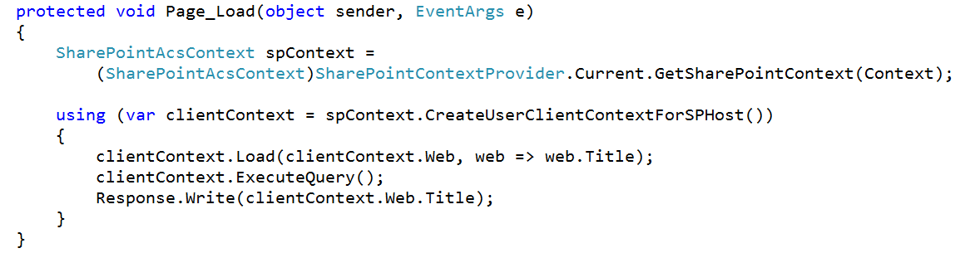
Making CSOM Calls with OAuth

Slide 43
demo
Provider-Hosted App

Slide 44
Office 365 APIs
Development Scenarios

Slide 45
Office 365 APIS Flow Scenario
User has Organizational Account
Application deployed as an Azure Web Site
Application does not require explicit permission grant

Slide 46
OAuth 2.0 Flow Office 365 APIs
Azure Web Site
(Client)
End User
(Resource Owner)
Azure Active Directory
(Authorization Server)
SharePoint Online
(Resource Server)

Slide 47
OAuth 2.0 Flow Office 365 APIs
Azure Web Site
(Client)
User accesses
Web application
End User
(Resource Owner)
Azure Active Directory
(Authorization Server)
SharePoint Online
(Resource Server)

Slide 48
OAuth 2.0 Flow Office 365 APIs
Azure Web Site
(Client)
End User
(Resource Owner)
Redirected to AAD
Azure Active Directory
(Authorization Server)
SharePoint Online
(Resource Server)

Slide 49
OAuth 2.0 Flow Office 365 APIs
Azure Web Site
(Client)
End User
(Resource Owner)
Consent dialog
displayed
Azure Active Directory
(Authorization Server)
SharePoint Online
(Resource Server)

Slide 50
OAuth 2.0 Flow Office 365 APIs
Azure Web Site
(Client)
Grant access using
Consent Dialog
End User
(Resource Owner)
Azure Active Directory
(Authorization Server)
SharePoint Online
(Resource Server)

Slide 51
OAuth 2.0 Flow Office 365 APIs
Azure Web Site
(Client)
Auth Code
returned and
user redirected
End User
(Resource Owner)
Azure Active Directory
(Authorization Server)
SharePoint Online
(Resource Server)

Slide 52
OAuth 2.0 Flow Office 365 APIs
Azure Web Site
(Client)
Auth Code,
App Id, App Secret
sent
End User
(Resource Owner)
Azure Active Directory
(Authorization Server)
SharePoint Online
(Resource Server)

Slide 53
OAuth 2.0 Flow Office 365 APIs
Azure Web Site
(Client)
Access and Refresh
Tokens returned
End User
(Resource Owner)
Azure Active Directory
(Authorization Server)
SharePoint Online
(Resource Server)

Slide 54
OAuth 2.0 Flow Office 365 APIs
Azure Web Site
(Client)
End User
(Resource Owner)
Access Token presented
Along with request
Azure Active Directory
(Authorization Server)
SharePoint Online
(Resource Server)

Slide 55
OAuth 2.0 Flow Office 365 APIs
Azure Web Site
(Client)
End User
(Resource Owner)
Response returned
Azure Active Directory
(Authorization Server)
SharePoint Online
(Resource Server)

Slide 56
Office 365 discovery services
Automatically determine URL of Office 365 services
Supports device app and website flows
Secured using Azure AD authentication
Serves information stored about services in AAD
Notes:
The heart of the Office 365 APIs is the discovery service
Discovery services allow you to locate the e resource you want to utilize

Slide 57
Office 365 Clients
AadGraphClient – Azure Active Directory
ExchangeClient – Calendar, Contacts, Mail
SharePointClient - Files

Slide 58
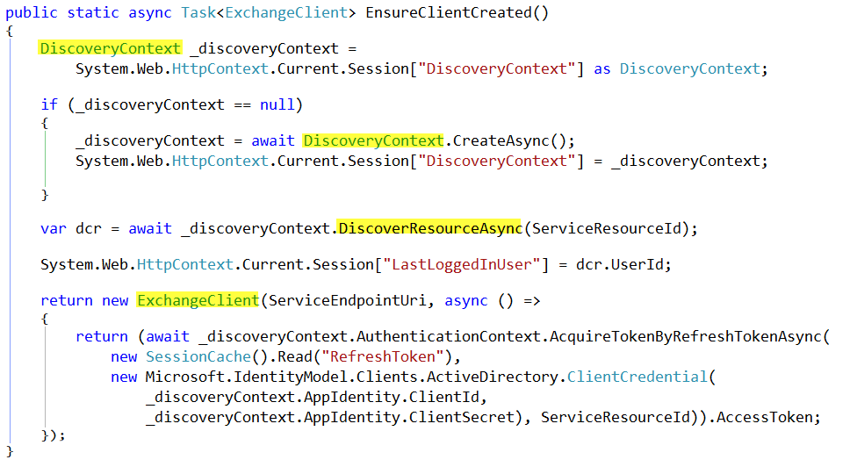

Slide 59
OAuth Controller
Development Scenarios

Slide 60
OAuth Controller class
Embodies all OAuth operations
Allows code customizations for special situations
Available on GitHub
https://github.com/AzureADSamples/WebApp-WebAPI-OAuth2-UserIdentity-DotNet/ blob/master/WebApp/Controllers/OAuthController.cs
Notes:
The Oauth controller should be used in scenarios where you need to customize how tokens are handled. For example, you might want to save them to a database and make them available across sessions.

Slide 61
OAuth Controller Flow Scenario
User has Organizational Account
App deployed as an Azure Web Site
App registered with Azure Active Directory
Client ID and Client Secret defined in AAD
Permissions granted specifically in AAD

Slide 62
OAuth 2.0 Flow OAuth Controller
Azure Web Site
(Client)
End User
(Resource Owner)
Azure Active Directory
(Authorization Server)
SharePoint Online
(Resource Server)

Slide 63
OAuth 2.0 Flow OAuth Controller
Azure Web Site
(Client)
User accesses
Web application
End User
(Resource Owner)
Azure Active Directory
(Authorization Server)
SharePoint Online
(Resource Server)

Slide 64
OAuth 2.0 Flow OAuth Controller
Azure Web Site
(Client)
End User
(Resource Owner)
Redirected to AAD
Azure Active Directory
(Authorization Server)
SharePoint Online
(Resource Server)

Slide 65
OAuth 2.0 Flow OAuth Controller
Azure Web Site
(Client)
The consent form is not utilized when permissions are explicitly granted in AAD.
Auth Code
returned and
user redirected
End User
(Resource Owner)
Azure Active Directory
(Authorization Server)
SharePoint Online
(Resource Server)

Slide 66
OAuth 2.0 Flow OAuth Controller
Azure Web Site
(Client)
Auth Code,
App Id, App Secret
sent
End User
(Resource Owner)
Azure Active Directory
(Authorization Server)
SharePoint Online
(Resource Server)

Slide 67
OAuth 2.0 Flow OAuth Controller
Azure Web Site
(Client)
Access and Refresh
Tokens returned
End User
(Resource Owner)
Azure Active Directory
(Authorization Server)
SharePoint Online
(Resource Server)

Slide 68
OAuth 2.0 Flow OAuth Controller
Azure Web Site
(Client)
End User
(Resource Owner)
Access Token presented
Along with request
Azure Active Directory
(Authorization Server)
SharePoint Online
(Resource Server)

Slide 69
OAuth 2.0 Flow OAuth Controller
Azure Web Site
(Client)
End User
(Resource Owner)
Response returned
Azure Active Directory
(Authorization Server)
SharePoint Online
(Resource Server)

Slide 70
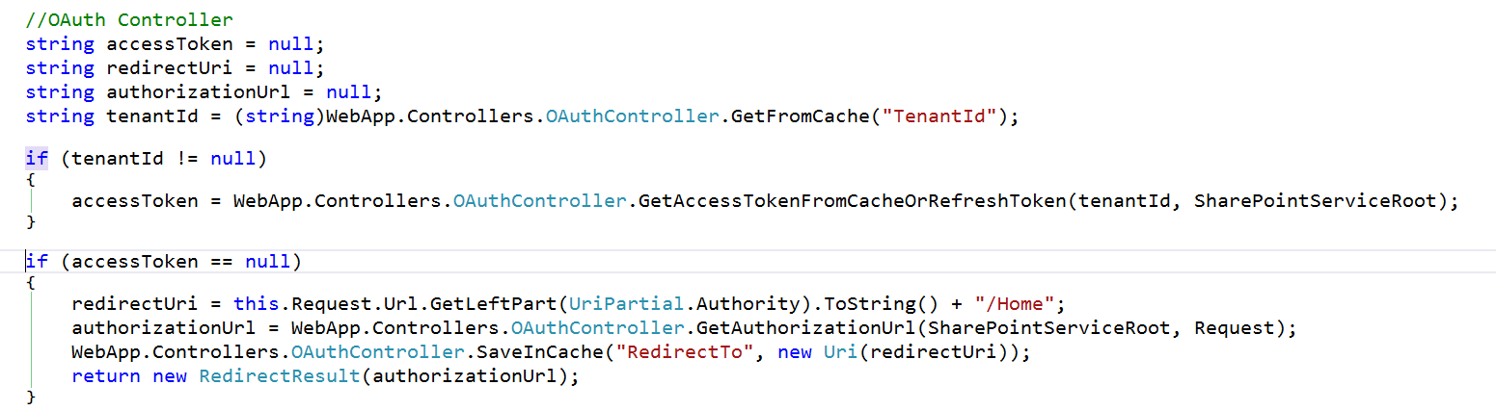
Programming the OAuth Controller
Notes:
The Oauth controller needs you to provide a redirect URL and it will give back the authorization URL

Slide 71
demo
Oauth Controller

Slide 72
Authorization Code Flow Client Credentials Flow
OAuth Flows

Slide 73
Obtain Access Tokens with OAuth Flows
Obtain access tokens using different defined “OAuth Flows”
Multiple flows defined in OAuth 2.0 spec
Both the Issuer & Resource must support the flow to use it
Flow Options with Office 365 & Azure AD
Authorization Code Flow
Client Credentials Flow (App only)
Implicit Flow

Slide 74
Authorization Code Flow
Most common
Very secure - application never gets user’s creds
Flow described:
Web app redirects user to Azure AD to login
Upon successful login, Azure AD redirects user back to web app with an authorization code
Web app uses this code to request access token on behalf of user
Scenarios:
Web applications that use federated logins
User interaction present

Slide 75
Client Credentials Flow (aka: App Only)
Very powerful
Requires global tenant admin consent
Not user consent
Flow described:
App configured with the public part of a certificate
App submits an encrypted request to the issuer requesting access token
Issuer returns access token back to requestor
Scenarios:
App only rights
Zero user interaction
Service / daemon processes

Slide 76
demo
Client Credentials Flow

Slide 77
Summary
Azure Active Directory
OAuth Primer
Development Scenarios
OAuth Flows

Slide 78


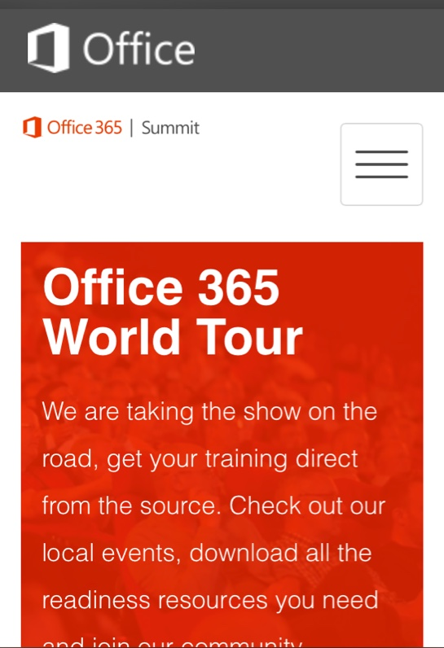
dev.office.com
Sign up
http://dev.office.com/getting-started
Explore
http://apisandbox.msdn.microsoft.com
Get trained http://dev.office.com/training

Slide 79


Feedback
Office 365 Network Share you best practices and join conversations https://www.yammer.com/itpronetwork
Stackoverflow Ask deep technical questions to a world-wide set of developers
http://stackoverflow.com/questions/tagged/ms-office
UserVoice Provide suggestions of what you want in future versions
http://officespdev.uservoice.com/

Slide 80

© 2012 Microsoft Corporation. All rights reserved. Microsoft, Windows, and other product names are or may be registered trademarks and/or trademarks in the U.S. and/or other countries.
The information herein is for informational purposes only and represents the current view of Microsoft Corporation as of the date of this presentation. Because Microsoft must respond to changing market conditions, it should not be interpreted to be a commitment on the part of Microsoft, and Microsoft cannot guarantee the accuracy of any information provided after the date of this presentation. MICROSOFT MAKES NO WARRANTIES, EXPRESS, IMPLIED OR STATUTORY, AS TO THE INFORMATION IN THIS PRESENTATION.

